Slide 1
Machine Learning Approach For Predictive Maintenance Aircraft Engine Using IBM Watson Studio
PRESENTED BY:
TEAM NO:CSE-004
18UK1A0509 - SAI CHANDANA PALA
18UK1A0572 – KANCHA DINESH
18UK1A0508 – BOINAPALLY DEVIKA
18UK1A0548 – PUNNAM NAGAVARDHAN REDDY

Slide 2
OUTLINE
INTRODUCTION
OBJECTIVE
DATA
MACHINE LEARNING APPROACHES
VISUALIZATION OF GRAPHS
SOFTWARE REQUIREMENTS
CONCLUSION

Slide 3
INTRODUCTION
Engine failure is highly risky and needs a lot of time for repair. Unexpected failure leads to loss of money and time. Predicting the failure prior, will save time, effort, money and sometimes even lives. The failure can be detected by installing the sensors and keeping a track of the values. The failure detection and predictive maintenance can be for any device, out of which we will be dealing with the engine failure for a threshold number of days.
The project aims to predict the failure of an engine by using Machine Learning to save loss of time & money thus improving productivity.
We use machine learning algorithms to predict failure of an engine. The model give to types of predictions, which includes manual prediction and automatic prediction . Thus a user can get an appropriate time of failure of an aircraft engine.

Slide 4
OBJECTIVE
By the end of this project:
You’ll be able to understand the problem to classify if it is a regression or a classification kind of problem.
You will be able to know how to pre-process/clean the data using different data pre-processing techniques.
Apply different algorithms according to the dataset
You will be able to know how to find the accuracy of a model.
You will be able to Build web applications using the Flask framework.

Slide 5
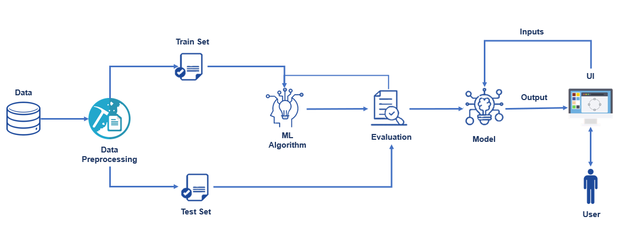
FLOW CHART

Slide 6
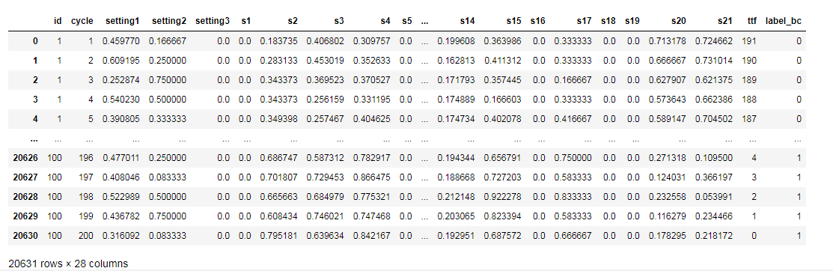
DATA
Machine Learning Approach For Predictive Maintenance Aircraft Engine dataset consists of:
20631 rows × 28 columns
'id', 'cycle', 'setting1', 'setting2', 'setting3', 's1', 's2', 's3','s4', 's5', 's6', 's7', 's8', 's9', 's10', 's11', 's12', 's13', 's14','s15', 's16', 's17', 's18', 's19', 's20', 's21', 'ttf', 'label_bc‘
Data source: Internet

Slide 7
DATA VISUALIZATION
Data visualization is where a given dataset is presented in a graphical format. It helps the detection of patterns, trends and correlations that might go undetected in text-based data. Understanding your data and the relationship present within it is just as important as any algorithm used to train your machine learning model. Machine learning models will perform poorly on data that wasn’t visualized and understood properly.
To visualize the dataset we need libraries called Matplotlib and Seaborn. The Matplotlib library is a Python 2D plotting library that allows you to generate plots, scatter plots, histograms, bar charts etc.

Slide 8
MODEL BUILDING
There are several Machine learning algorithms to be used depending on the data you are going to process such as images, sound, text, and numerical values. The algorithms that you can choose according to the objective that you might have it may be Classification algorithms are Regression algorithms.
Example:
1.Linear Regression
2.Logistic Regression
3. Random Forest Regression / Classification.
4. Decision Tree Regression / Classification.
You will need to train the datasets to run smoothly and see an incremental improvement in the prediction rate.
On our Dataset , we have applied Linear Regression to predict the Accuracy.

Slide 9
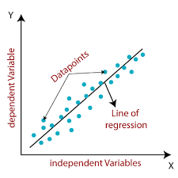
MACHINE LEARNING ALGORITHMS
Linear Regression:
Linear Regression is a supervised machine learning algorithm where the predicted output is continuous and has a constant slope. It's used to predict values within a continuous range, (e.g. sales, price) rather than trying to classify them into categories (e.g. cat, dog).
Steps to implement Linear regression model:
Initialize the parameters.
Predict the value of a dependent variable by given an independent variable.
Calculate the error in prediction for all data points.
Calculate partial derivative w.r.t a0 and a1.
Calculate the cost for each number and add them.

Slide 10
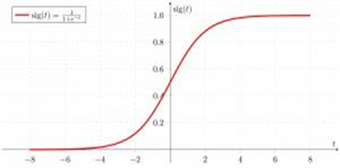
Multiple Linear Regression
Multiple Linear Regression is one of the important regression algorithms which models the linear relationship between a single dependent continuous variable and more than one independent variable.
Random Forest
A random forest is a machine learning technique that’s used to solve regression and classification problems. It utilizes ensemble learning, which is a technique that combines many classifiers to provide solutions to complex problems.
Working of Random Forest Algorithm
Step 1 − First, start with the selection of random samples from a given dataset.
Step 2 − Next, this algorithm will construct a decision tree for every sample. Then it will get the prediction result...
Step 3 − In this step, voting will be performed for every predicted result.
Step 4 − At last, select the most voted prediction result as the final prediction result.

Slide 11
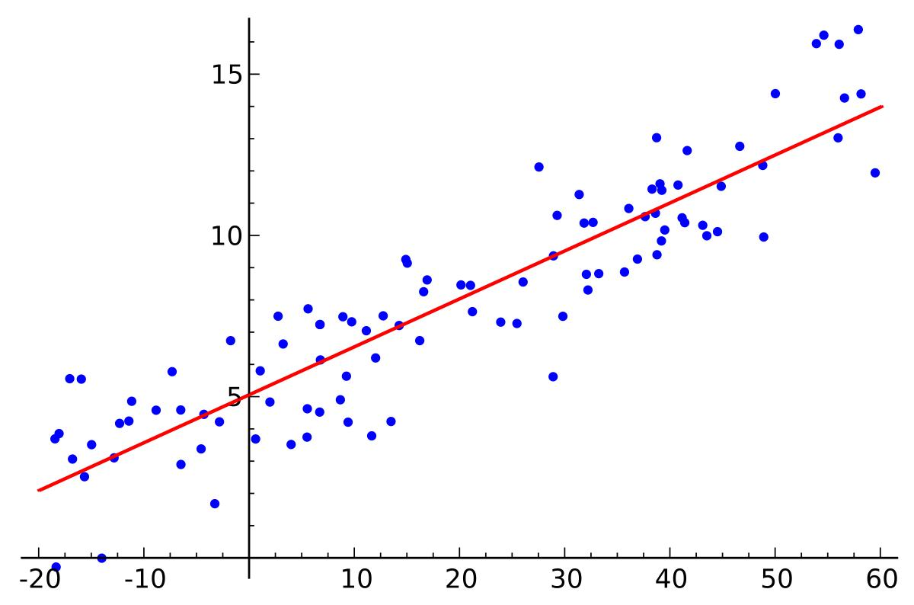
LOGISTIC REGRESSION:
Logistic regression is a supervised learning classification algorithm used to predict the probability of a target variable. The nature of target or dependent variable is dichotomous, which means there would be only two possible classes. ... Mathematically, a logistic regression model predicts P(Y=1) as a function of X.
Logistic Regression is used when the dependent variable (target) is categorical. For example,
To predict whether an email is a spam (1) or (0)
Whether the tumor is malignant (1) or not (0)

Slide 12
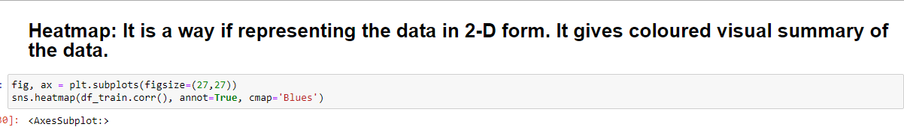
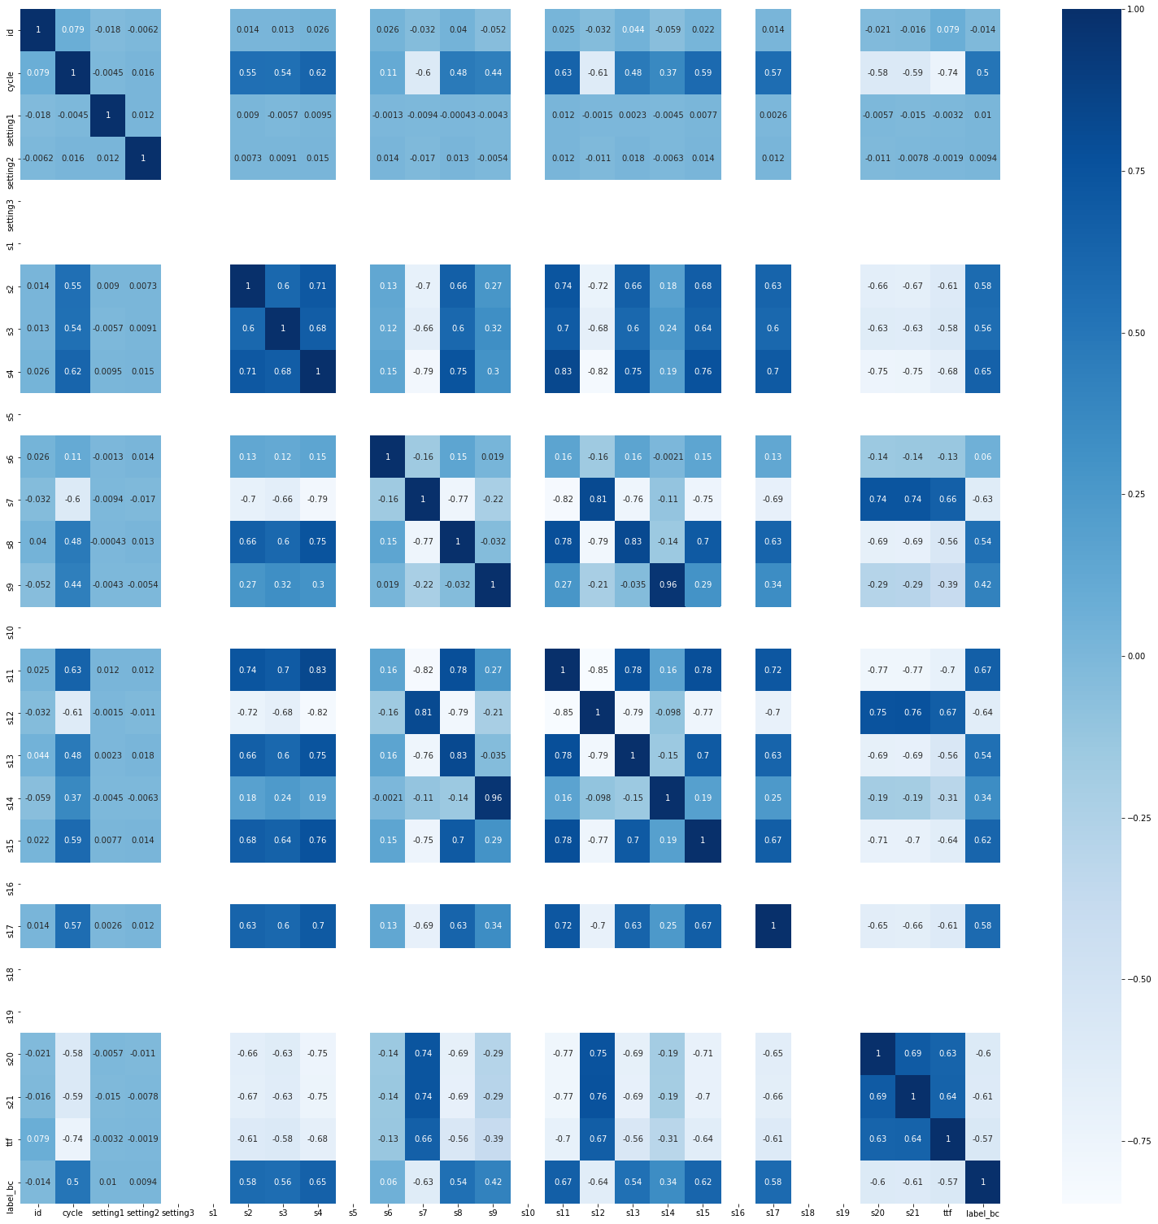
VISUALISATION OF GARPHS

Slide 13
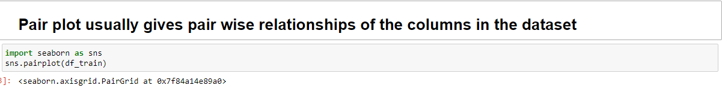
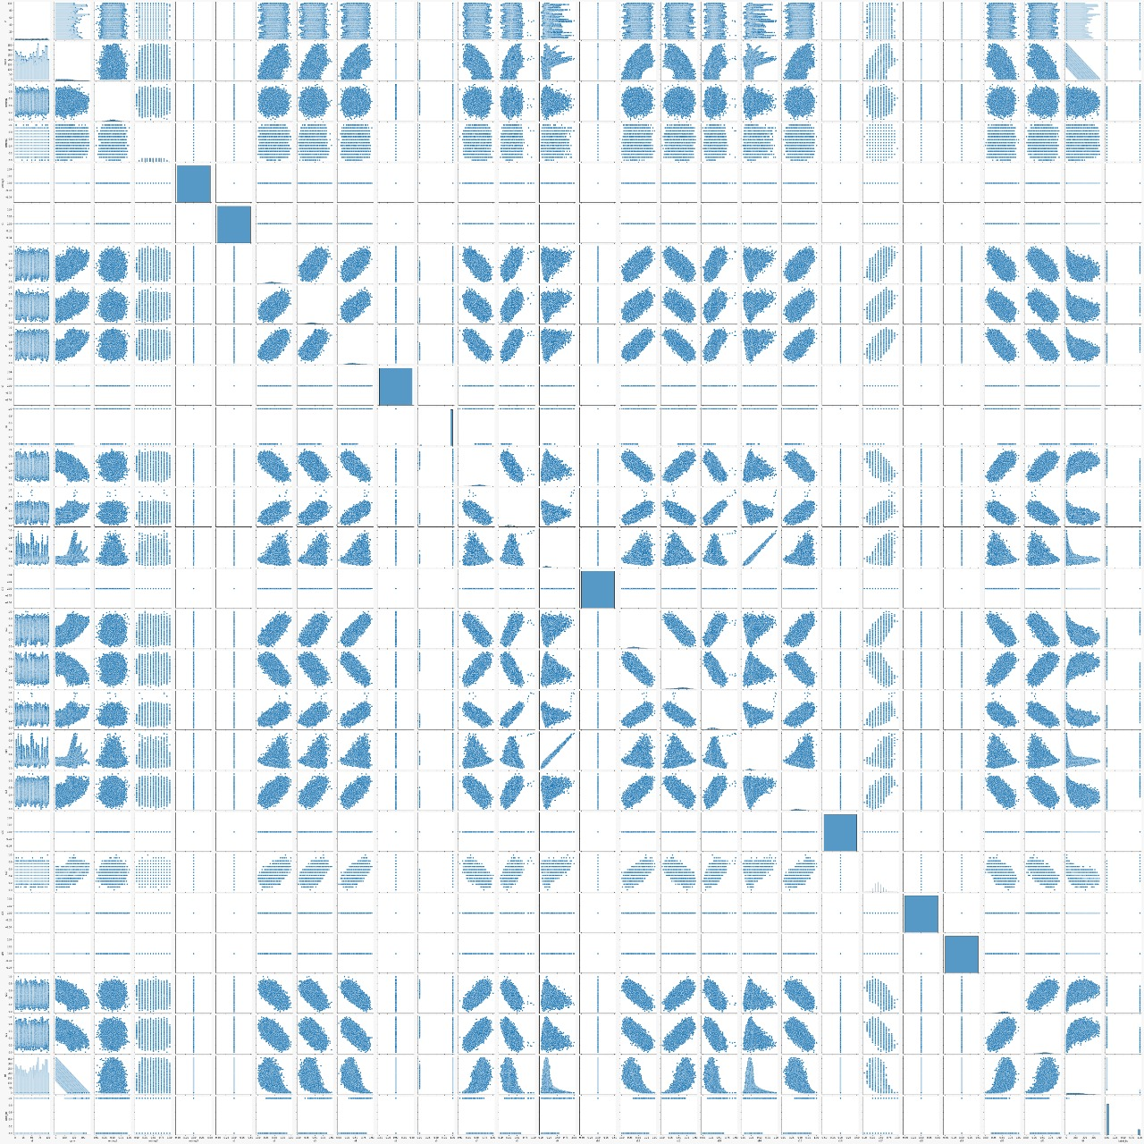

Slide 14
IBM WATSON STUDIO
IBM Acquired soft layer, a public cloud platform, to serve as the foundation for its IaaS offering. In October 2016, IBM rolled the soft layer brand under its Blue mix brand of PaaS offerings, giving users to access both IaaS and PaaS resources from a single console. IBM cloud provides a full-stack, public cloud platform with various products in the catalog, including options for compute, storage, networking, end to end developer solutions for app development, testing and deployment, security databases, and cloud native services.
We Created the IBM cloud account by going to the IBM cloud login page. Then we login to IBM Watson Studio and deployed our model on IBM.
Advantages of deploying model on CLOUD:
Security and privacy. Much like a private cloud, you can ensure your data remains secure when you are the only organization that uses the private portion of your infrastructure.
Potential cost savings.
Superior flexibility and scalability.

Slide 15
SOFTWARE REQUIREMENTS
Anaconda navigator
Jupyter notebook
IBM watson Studio
Machine learning tools: pandas,
numpy,
matplotlib,
scikitlearn,
seaborn

Slide 16
CONCLUSION
In this project we have calculated estimated time for failure of an aircraft engine depending on different factors.
We have achieved this by using Machine Learning model,
For better results we used Logistic Regression model and proved with 99% accuracy.

